Slide 1

Durgapur Institute of Advanced Technology and Management
Group Number - 05
Project Title: SKIN DISEASE DETECTION USING MACHINE LEARNING TECHNIQUE
Under the supervision of
Prof. Kaustav Sanyal
Presented by:
Name University Roll
SIDDHARTHA MAJUMDER | 15500121027
RAHUL KUMAR SINGH | 15500121016
PUSKAR SARKAR | 15500121017
ARYAN RAJ | 15500121031
DEBKUMAR MANDAL | 15500121004

Slide 2
Contents:
Introduction
Objectives
Scope
system architecture
system requirements
Future Improvements
Conclusion

Slide 3
Introduction:
The skin is the biggest and most sensitive part of our body.
The skin helps keep bacteria and viruses out of our body.
Skin diseases are problems that affect our skin, like rashes, bumps, or changes in color.
They can happen because of things like infections, allergies, or even just too much sun.
Skin diseases can be uncomfortable and sometimes they can make us feel self-conscious.

Slide 4
Objectives:
Create a system to automatically detect skin diseases from images.
Make it easier for people to check skin changes without always needing a doctor.
Use machine learning, specifically deep learning models, to identify skin diseases.
Train the model to achieve high accuracy in predicting different types of skin diseases.

Slide 5
Scope:
Our propose project will work in the following ways:
Acquire images
Classify disease
Upload classified image to web app for further option

Slide 6
The application will be able to classify the following diseases:
Eczema
Melanoma
Atopic Dermatitis
Basal Cell Carcinoma (BCC)
Melanocytic Nevi (NV)
Benign Keratosis-like Lesions (BKL)
Psoriasis pictures Lichen Planus
Seborrheic Keratoses
Tinea Ringworm Candidiasis
Warts Molluscum

Slide 7
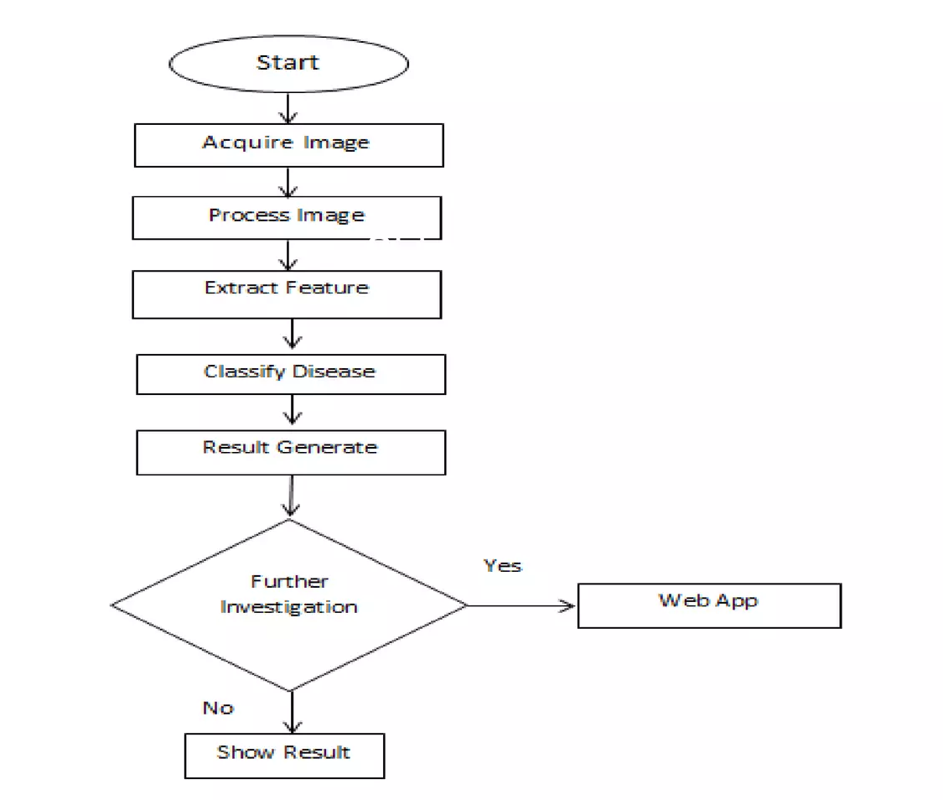
FLOW CHART:

Slide 8
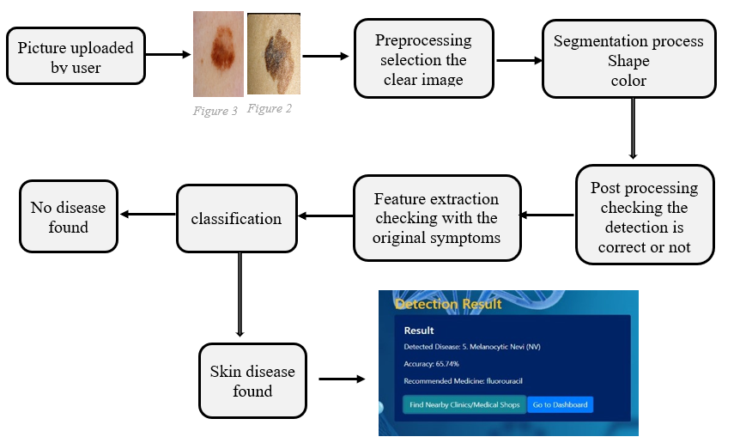
SYSTEM ARCHITECTURE:

Slide 9
SYSTEM REQUIREMENTS:
Operating System: Windows, Mac OS, Linux
Application: Spyder with Python 3.0 or above
LIBRARIES USED:
TensorFlow
Pandas
NumPy
OpenCV
Keras

Slide 10
Future Improvements:
Expand Dataset: Include diverse skin types and demographics.
Enhance Models: Use advanced architectures like EfficientNet.
Real-Time Analysis: Implement instant feedback features.
Better UI: Improve Android app interface.
Privacy: Ensure robust data security.
Clinical Trials: Validate model effectiveness.
Continuous Learning: Enable ongoing model updates.

Slide 11
Conclusion:
Developing and implementing an advanced skin disease detection system for healthcare allows individuals to assess their skin condition from home using web-based tools.
This reduces the burden on the healthcare system and promotes better skin health.
As technology advances, these systems will provide faster and more accurate detection.

